Slide 1

CHECK-IN JUDGES

Slide 2
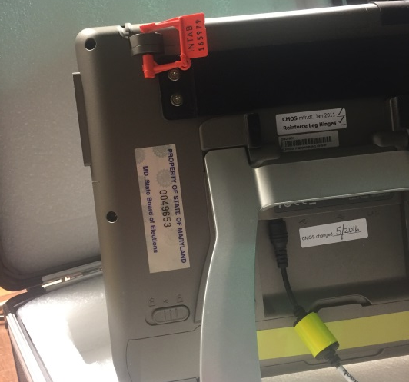
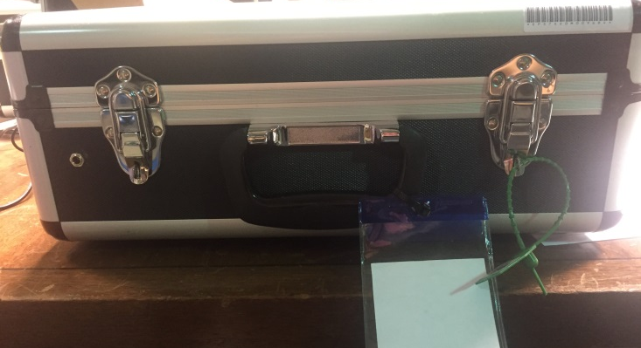
Night Before
Open all E-pollbook and printer cases – the opening integrity report will be inside E-pollbook case #1 (Page 1 of Handout)
Verify that all the E-pollbook outer seals (green) are correct using the opening portion of the integrity report
  Set up and plug in ALL E-pollbooks
  Verify the State Asset Tags and Inner Seals (orange) are correct and intact using the opening portion of the integrity report
DO NOT BREAK THE ORANGE SEALS OR CONNECT THE HUB
INNER
SEAL
OUTER SEAL
STATE ASSET TAG

Slide 3
Morning of – Opening the Polls
Verify once again that the State Asset Tag and Inner seals (orange) are correct and intact
Power on the E-pollbooks and open the polls
Print your Zero Reports (one from each pollbook)
  If all reports are printed and correct, CONNECT THE HUB
  Sign all zero reports and attach them to your integrity report
Get familiar with the items in your Check-in folder
  You will be responsible for reporting the hourly voter totals to your Chief Judge (Page 2 of Handout)
  Assist the Chief Judge in any further duties as assigned

Slide 4
During the Day
You will be issuing VAC slips to ALL voters – this includes provisional
Ask the voter for their last and first name, address and MONTH AND DAY of birth
If the voter is found and their information is correct issue them a VAC slip
If you are in a combo precinct, circle the voters’ ballot style (Page 3 of Handout)
Have the voter verify their information is correct and sign their name
You must initial the VAC AFTER the voter has verified and signed it
Point the voter to the Ballot Table

Slide 5
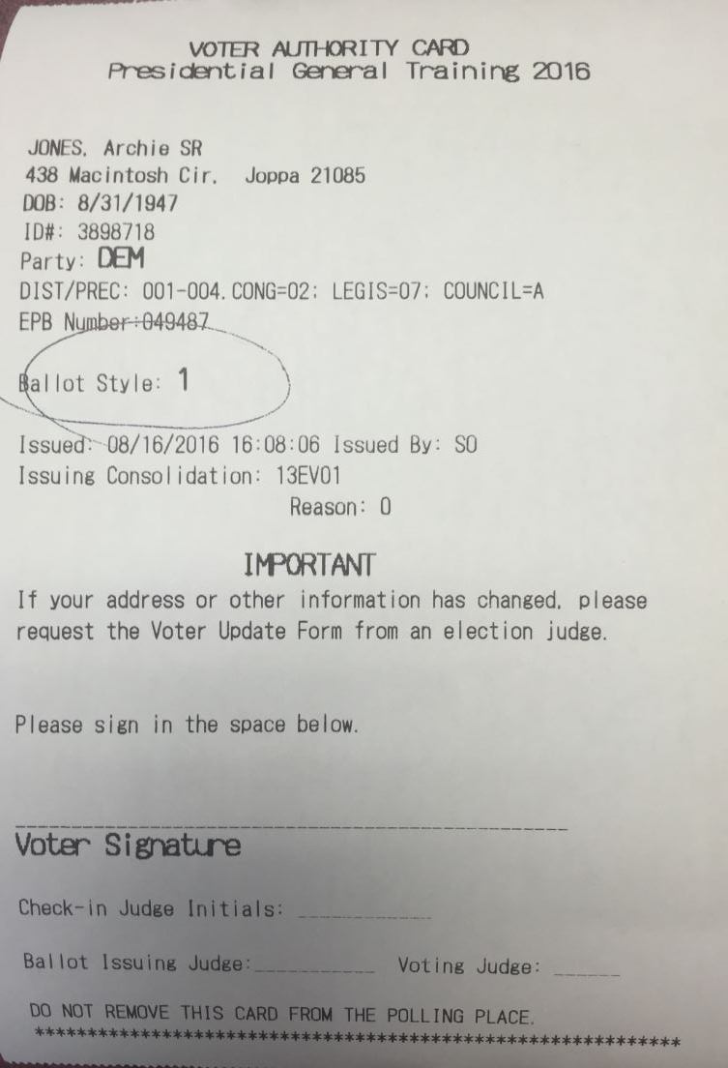
The VAC slip
The voter will confirm their personal information
Circle the voters’ ballot style
(for combo precincts only)
Your name is attached to each VAC you issue
The voter MUST sign the VAC slip to receive a ballot
Initial the VAC only after the voter has signed it
*Can be found on Page 3 of Handout

Slide 6
Scenarios for a Regular Ballot
Voters’ status reads:
  Active – perfect voter
  Inactive but signs Affirmation of Residency*
  Active (ID Required) and can produce ID *
  Inactive (ID Required) and can produce ID and signs Affirmation of Residency*
Voter has moved within the last 21 days *
  BETWEEN OCTOBER 18, 2016 and NOVEMBER 8, 2016
  *Voter Update Form Required (Page 4 of Handout)

Slide 7
Scenarios for a Provisional Ballot
Voter has moved more than 21 days prior to Election Day
  PRIOR TO OCTOBER 18, 2016
Voters’ status reads:
  Pend1 (ID Required)
  Pend2 (Need DL/SSN)
  Active (ID Required) and can’t produce ID
  Inactive (ID Required) and can’t produce ID
Voters’ Issued column reads:
  Reg Issued/ABS Issued/Voted Early/ SDR

Slide 8
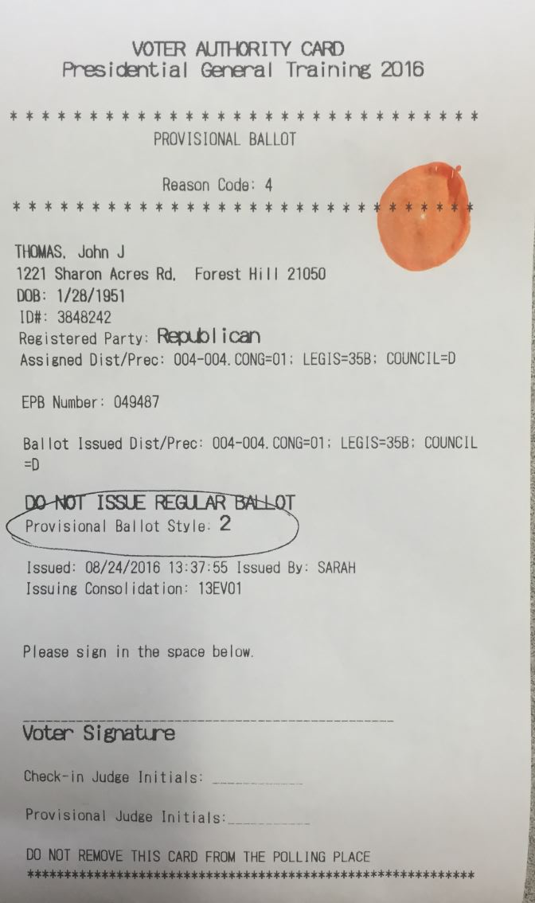
Provisional VAC
Differences:
Identified as “Provisional Ballot” and the reason code for why it is being issued
You must mark the provisional VAC with an orange dabber
“DO NOT ISSUE A REGULAR BALLOT” is stated on the VAC
If the voter is in a combo precinct, circle the voters’ ballot style
*Provisional VAC can be found on Page 5 of the Handout and the list of Reason Codes can be found on Page 6 of the Handout

Slide 9
End of Night - Closing the Polls
Record the total number of voters for the end of night tally (Page 2 of Handout)
Print totals report from ONE pollbook and sign. Attach this report to the integrity report (Page 1 of Handout)
Finish closing the polls on ALL pollbooks and turn off
Break orange seals from tops of pollbooks and remove the small CF card and the Adapter. Give them to your Chief Judge
  Pack all E-pollbook supplies in their cases (pollbooks, wires, printers, etc.)
  Secure the cases with the cart
  Assist Chief Judges with any other duties as assigned

