Slide 1

VOTING JUDGES

Slide 2
Night Before
Set up and plug in the Ballot Marking Device (BMD)
  This should be on a table along with a leg-free privacy screen for voters who wish to sit to vote
Assemble and set up all voting booths
Plug in the Ballot Scanning Unit(s) (BSU)
Set up the Voting Judge table
DO NOT BREAK ANY SEALS – only break the pollbook outer seals for setup
Assist with any set-up as necessary including pollbooks and interior signage

Slide 3
Morning Of – Opening the Polls
If instructed, assist the Chief Judges with completing the opening portion of the BSU(s) and BMD(s) integrity report(s)(See Pages 1-3 of Handout)
Unvoted ballots are stored in the ballot transfer bin in the cart – remove ballot bins and give to the Ballot Judge
Make sure the Ballot Judge records the seal numbers on all ballot transfer bins and place the empty ballot bin(s) in the scanning unit
Lock and seal the BSU
Assist with any set-up as necessary

Slide 4
During the Day - Marking a Ballot
Instruct the voters that they must fill in the oval darkly and completely
If the voter wishes to write in a candidate they MUST fill in the oval as well
There are two sides to their ballot – make sure to check both sides
Proceed to the scanner when finished voting
Notes:
*instruct judges about privacy folder to block view

Slide 5
During the Day – The BMD
DO NOT offer the machine to voters
If one voter uses the BMD you MUST get an additional voter to use the machine for anonymity
There will be a privacy screen placed on a table for voters who wish to sit
If you are in a combo precinct, you will select the precinct for the voter based on their VAC slip
If a voter insists on using the BMD audio ballot you will explain how to select their options using the keypad
Inform the voter that if they have questions to raise their hand
Always assist a voter in a bi-partisan team
*See Page 4 of Handout for “how to write-in” on the BMD

Slide 6
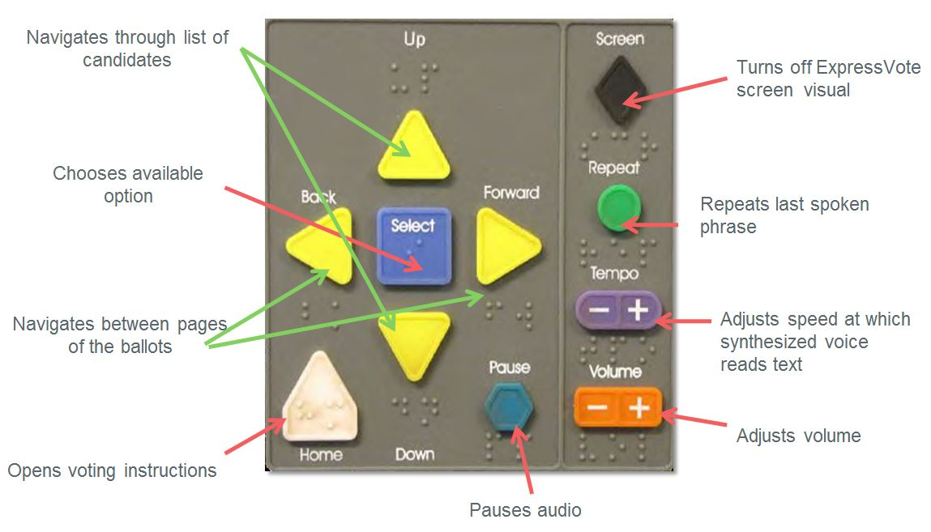
The BMD Keypad

Slide 7
During the Day – Spoiled Ballots
Spoiling a paper ballot
  Direct the voter back to a voting booth
  Without looking at their ballot, tell the voter to write “SPOILED” in large letters across BOTH sides of their ballot
  Instruct the voter to draw a vertical line through all the ovals
  Direct the voter to the Ballot Judge to get a new ballot
Spoiling a Ballot Activation Card (BAC)
  Direct the voter to a voting booth
  Without looking at their ballot, tell the voter to mark through all barcodes and write “SPOILED” in large letters across it
  Direct the voter to the Ballot Judge to get a new BAC

Slide 8
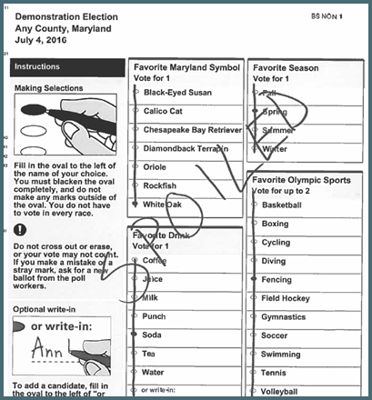
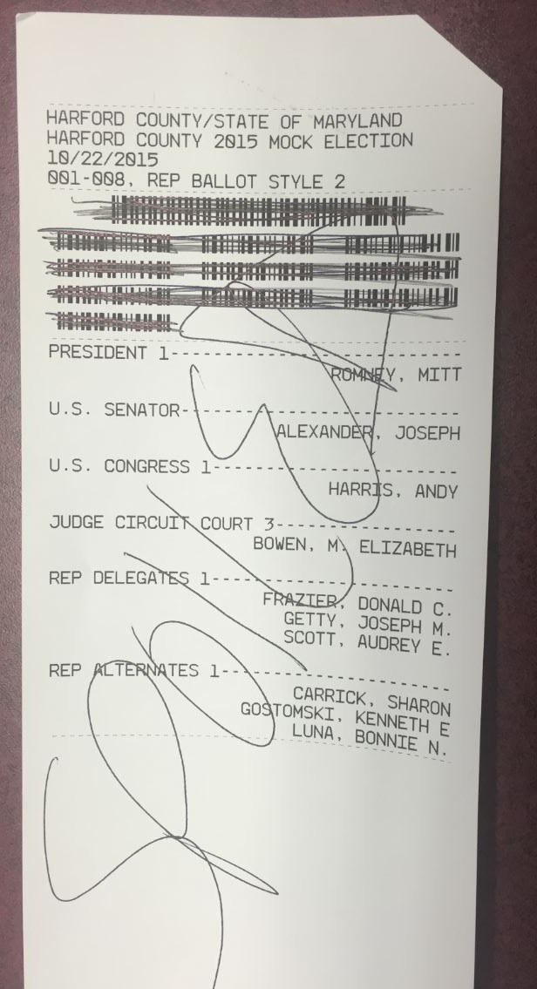

Slide 9
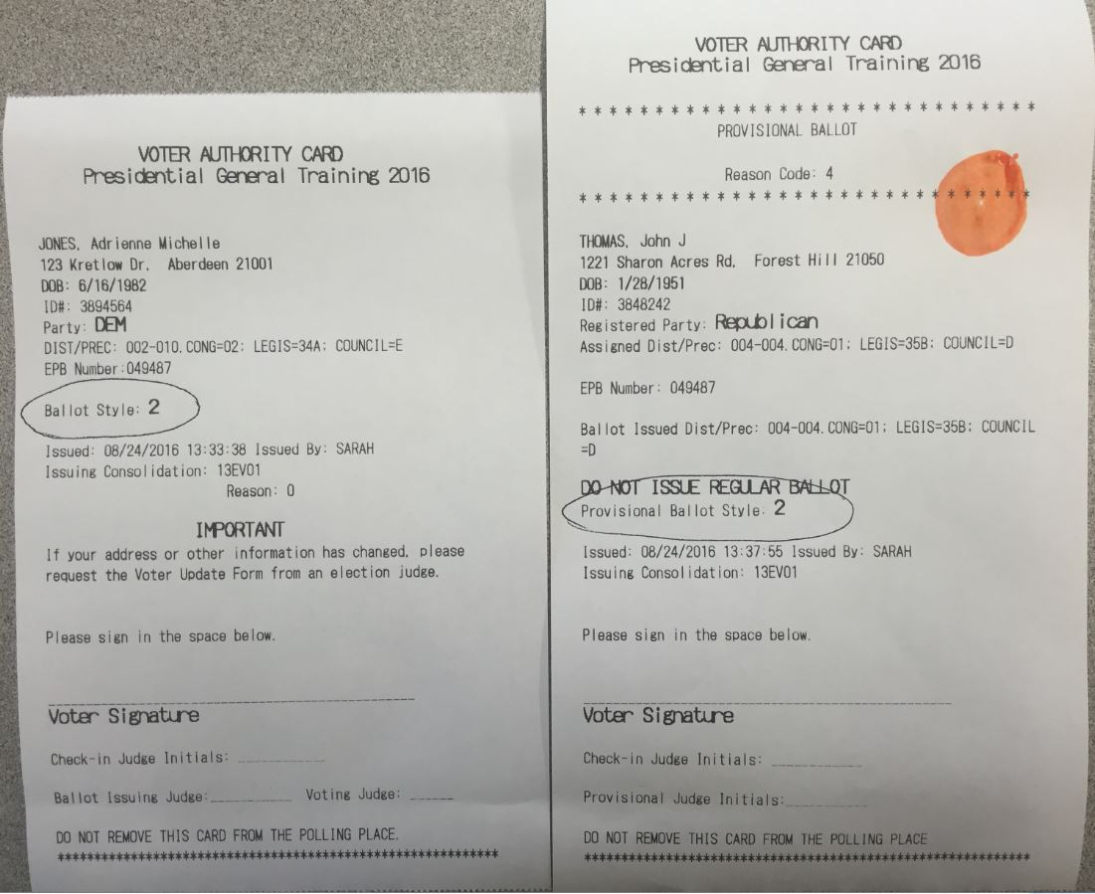
Regular VAC vs. Provisional VAC
*See Page 5 of Handout
IF YOU SEE THIS, STOP!

Slide 10
During the Day- Scanning a Ballot
If you are a Voting Judge at the scanner:
  Ask for the voters’ VAC – DO NOT TOUCH THE VOTERS’ BALLOT
  Instruct the voter to insert their ballot into the scanner – MAKE AN EFFORT TO LOOK AWAY FROM THE VOTERS’ BALLOT
  Initial voters’ VAC only AFTER the scanner has read the voters’ ballot successfully
  Count VACs in groups of 25, staple in top RIGHT corner

Slide 11
End of Night
If instructed, assist the Chief Judges with completing the closing portion of the BSU(s) and BMD(s) integrity report(s)(See Pages 1-3 of Handout)
Secure the voted ballots in the ballot transfer bin(s)
Place the unvoted ballots into the bottom of the BSU(s)
Breakdown all equipment and pack supplies in cart(s) according to image provided
Do a final count of the VACs, rubber band them and place in the VAC return envelope
Notes:
* Extra VACs that do not add up to 25 staple them and record the number on the back

